Slide 1
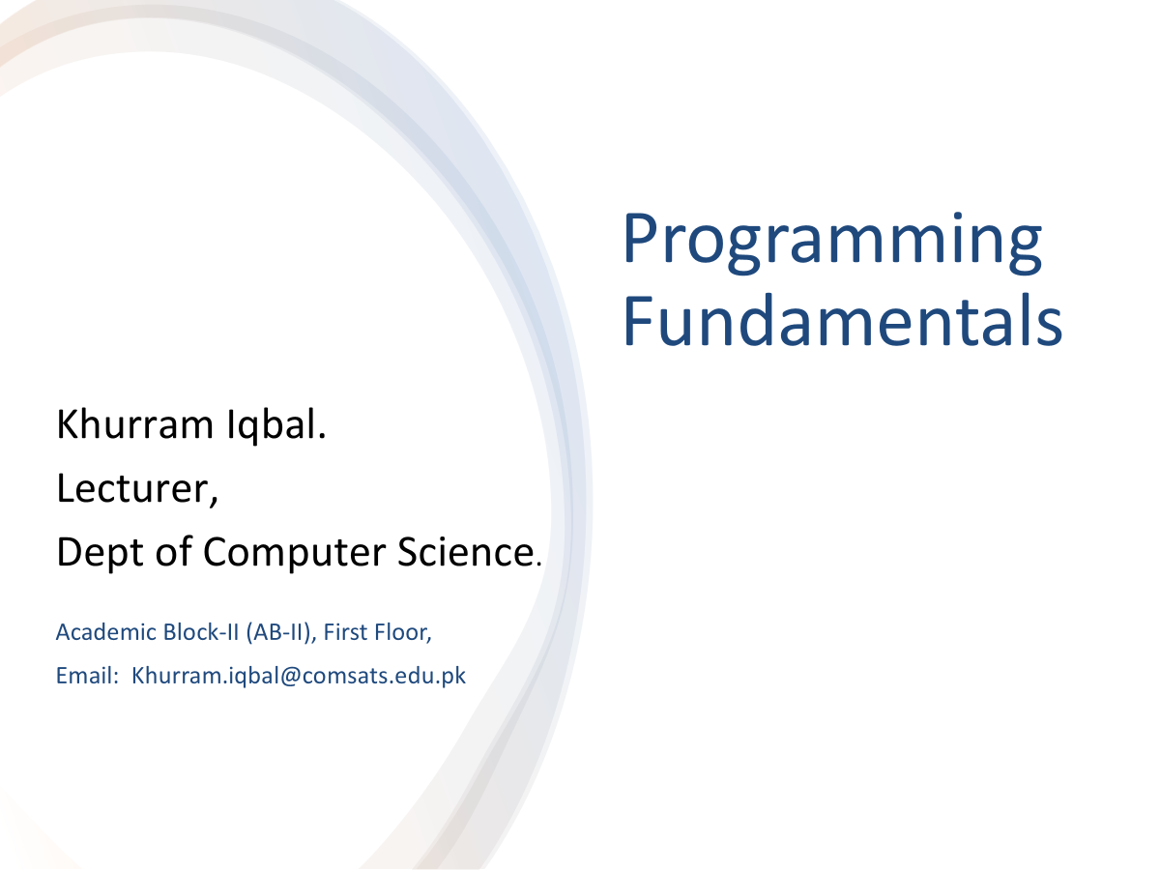

Slide 2
Lecture Outline
Trace a Program Execution
Variables, Constants
Standard Output Stream Object (System.out)
Reading Input using the Scanner class
Package, Classes, Methods and import

Slide 3
Trace a Program Execution
public class ComputeArea {
/** Main method */
public static void main(String[] args) {
double radius;
double area;
// Assign a radius
radius = 20;
// Compute area
area = radius * radius * 3.14159;
// Display results
System.out.println("The area for the circle of radius " +
radius + " is " + area);
}
}
memory
radius
no value
area
no value
allocate memory for area

Slide 4
Trace a Program Execution
public class ComputeArea {
/** Main method */
public static void main(String[] args) {
double radius;
double area;
// Assign a radius
radius = 20;
// Compute area
area = radius * radius * 3.14159;
// Display results
System.out.println("The area for the circle of radius " +
radius + " is " + area);
}
}
assign 20 to radius
radius
20
area
no value

Slide 5
Trace a Program Execution
public class ComputeArea {
/** Main method */
public static void main(String[] args) {
double radius;
double area;
// Assign a radius
radius = 20;
// Compute area
area = radius * radius * 3.14159;
// Display results
System.out.println("The area for the circle of radius " +
radius + " is " + area);
}
}
memory
radius
20
area
1256.636
compute area and assign it to variable area

Slide 6

Trace a Program Execution
public class ComputeArea {
/** Main method */
public static void main(String[] args) {
double radius;
double area;
// Assign a radius
radius = 20;
// Compute area
area = radius * radius * 3.14159;
// Display results
System.out.println("The area for the circle of radius " +
radius + " is " + area);
}
}
memory
radius
20
area
1256.636
print a message to the console

Slide 7
Input
Storing data in the computer’s memory is a two-step process:
Instruct the computer to allocate memory
Include statements in the program to put the data into to allocated memory

Slide 8
Variables
A variable is a named place in the memory where a programmer can store data (e.g. numbers and letters) and later retrieve the data using the variable “name”
Data item in a variable is called its value
You can change the contents of a variable in a later statement
double x;
int y;
x = 12.2;
y = 14;
12.2
x
14
y

Slide 9
Variables
A variable is a named place in the memory where a programmer can store data (e.g. numbers and letters) and later retrieve the data using the variable “name”
Data item in a variable is called its value
You can change the contents of a variable in a later statement
double x;
int y;
x = 12.2;
y = 14;
x = 10.2;
12.2
x
10.2
14
y

Slide 10
Variables
Declaration
Assignment Statement
int x;
double radius;
char a;
x = 1;
radius = 1.2;
a = ‘A’;
Declaration and Assignment
int x = 10;
double radius = 1.2;

Slide 11
Identify and fix the errors in the following code
1 public class Test {
2 public static void main(String[] args) {
3 int i = k + 2;
4 System.out.println(i);
5 }
6 }

Slide 12
Named Constants
A named constant is an identifier that represents a permanent value.
final datatype CONSTANTNAME = value;
Syntax
Example
final datatype CONSTANTNAME = VALUE;
final double PI = 3.14159;
final int SIZE = 3;

Slide 13
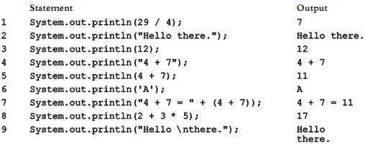
Output(System.out)
Standard output stream object (System.out)
System.out.print(expression);
System.out.println(expression);
System.out.println();

Slide 14
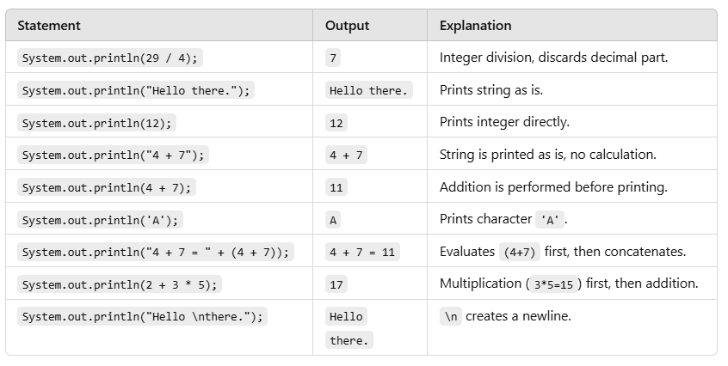
Output(System.out)
Standard output stream object (System.out)

Slide 15
Reading Input from the Console
Reading input from the console enables the program to accept input from the user.
System.in - standard input stream object
1. Create a Scanner object
Scanner input = new Scanner(System.in);
2. Use the method nextDouble() to obtain to a double value. For example,
System.out.println("Enter the radius of Circle");
double radius = input.nextDouble();

Slide 16
Reading Numbers from the Keyboard
Scanner input = new Scanner(System.in);
int value = input.nextInt();

Slide 17
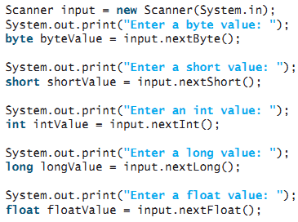
Reading Numbers from the Keyboard

Slide 18
Reading a character
Scanner input = new Scanner(System.in);
input.next(): get the next input token as string
input.nextLine(): get the next input as a string until the end of line
char ch = input.next().charAt(0);

Slide 19
Implicit Import and Explicit Import
There are two types of import statements: specific import and wildcard import. The specific import specifies a single class in the import statement. For example, the following statement imports Scanner from the package java.util.
import java.util.Scanner;
The wildcard import imports all the classes in a package by using the asterisk as the wildcard. For example, the following statement imports all the classes from the package java.util.
import java.util.*;

Slide 20
Implicit Import and Explicit Import
The information for the classes in an imported package is not read at compile time or runtime unless the class is used in the program. The import statement simply tells the compiler where to locate the classes.
There is no performance difference between a specific import and a wildcard import declaration.

Slide 21
Package, Classes, Methods and import
A package is a collection of related classes
java.lang package contain many classes e.g. Math, System
java.util package contain Scanner class
class is used to create Java programs
Use to group set of related operations(methods)
Specific Import:
import java.util.Scanner;
Wildcard Import:
import java.util.*;

Slide 22
import java.util.Scanner; // Scanner is in the java.util package
public class ComputeArea {
public static void main(String[] args){
// Create a Scanner object
Scanner input = new Scanner(System.in);
// Prompt the user to enter a radius
System.out.println("Enter the radius of Circle");
double radius = input.nextDouble();
// Compute area
double area = 3.14159 * radius * radius;
// Display results
System.out.print("The area of Circle is: "+area);
}
}

Slide 23
Reading Input from the Console
import java.util.Scanner; // Scanner is in the java.util package
public class ComputeAreaWithConsoleInput {
public static void main(String[] args) {
// Create a Scanner object
Scanner input = new Scanner(System.in);
// Prompt the user to enter a radius
System.out.print("Enter a number for radius: ");
double radius = input.nextDouble(); //method in Scanner class
// Compute area
double area = radius * radius * 3.14159;
// Display results
System.out.println("The area for the circle of radius " + radius + " is " + area);
}
}

Slide 24
Find Compilation Errors
improt java.util.Scanner;
public class SyntaxErrorExample
public static double PI = 3.14159;
public void main(String[] args) {
number = 10;
Scanner inputScanner = new scanner(System.in);
System.out.print("Enter a number: ")
int userNumber = inputScanner.nextinteger();
System.out.println("You entered: " + userNumber)
inputScanner.closeScanner();
}
}

Slide 25
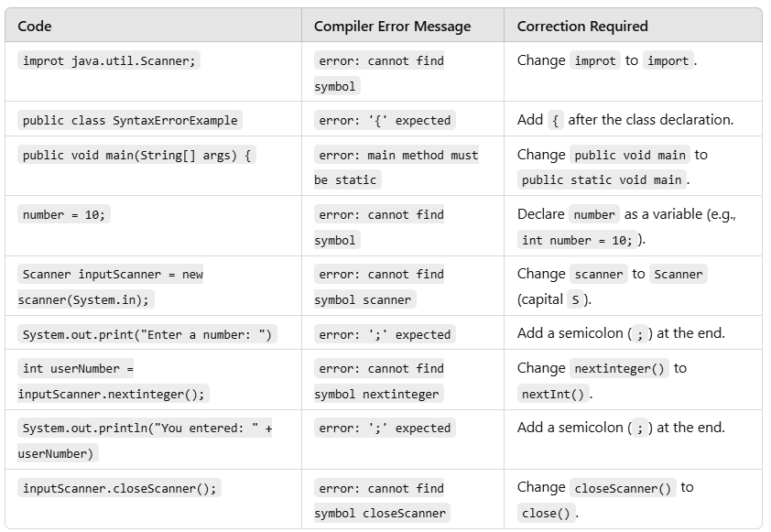
Identify and fix the errors in the following code

